Slide 1
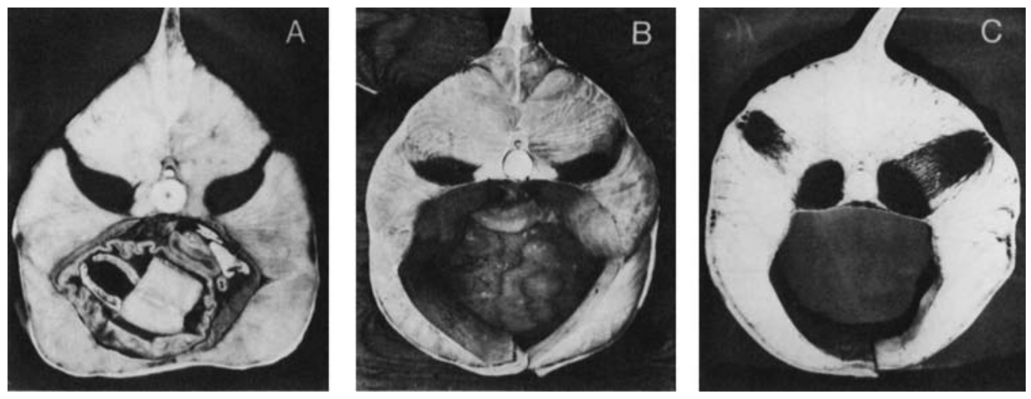
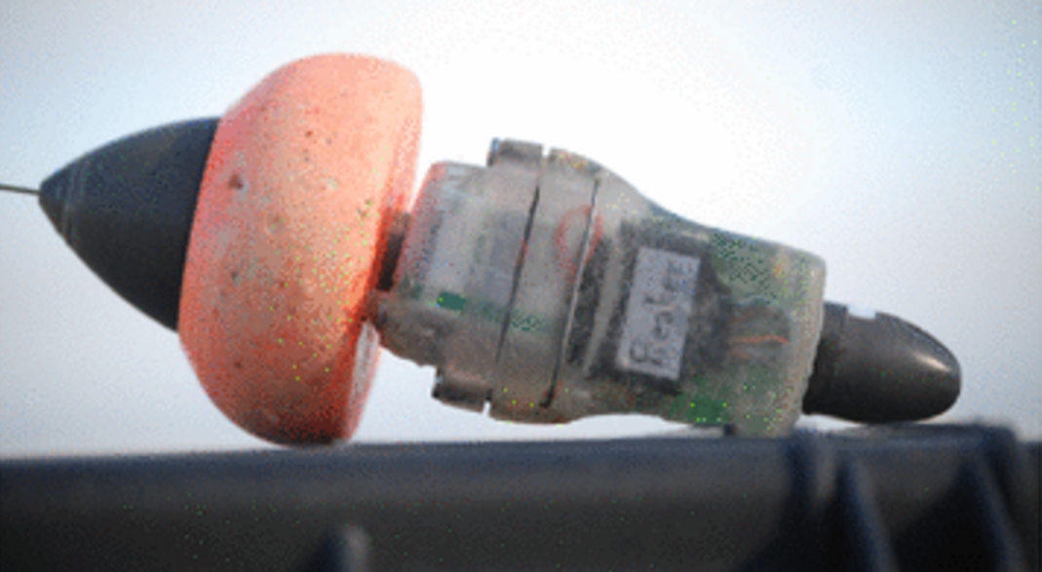



Variability in the stomach temperature of white sharks:
links to digestion and endothermy
CF White^{1*}, JH Moxley¹, AG Gleiss², PE Kanive¹,
TK Chapple³, SD Anderson¹, AB Carlisle³,
BA Block³, SJ Jorgensen¹
¹ Monterey Bay Aquarium USA
² Murdoch University AUS
³ Stanford University, USA
Introduction
Methods
Endothermy allows animals to operate across a wide range of ambient temperatures, expanding their physiological niche
Lamnid sharks are endothermic, with body temperatures recorded at >10° C above ambient
Variations in body temperature are related to energetics, feeding, and ration size in the wild
Feed sharks (n=9) accelerometer/PAT tag combo
Tags regurgitated after 1- 12 days
Variability in tag position used as
  proxy of stomach movement
Ambient temperature of 12-14 C
San Fransisco
These relationships require fine scale understanding of the causes of temperature variation
Fig 1. Cross sections of (A) mako, (B) white, and (C) porbeagle sharks, highlighting red muscle distribution, adopted from Carey et al. 1985
Fig 2. Tag Package ingested by sharks, consisting of daily diary, mk10 PAT tag, and additional flotation
Fig 3. Green circles are white shark aggregations (N-S order : Tomales Bay, Farallon, Ano Nuevo) in the Northeast Pacific
Results
Sharks display a wide range of stomach temperatures
Stomach temperature poorly predicted by length, ration size, depth, and tail beat duration
A
A
B
C
D
Fig 6. Average first 24 hour internal stomach temperature for each shark plotted against (A) shark length, (B) the weight of the meal surrounding the tag package, (C) the average depth of the shark over the first 24 hours, and (D) tail beat duration. Stomach temperatures were not significantly predicted by length (F= 2.44, p = 0.016), ration size (F=1.07, p = 0.35), swimming depth (F=0.52, p = 0.49), or tail beat duration (F=1.525, p = 0.263).
Fig 4. (A) Stomach temperature of 9 white sharks, measured by ingested PAT tags. Colors represent individual sharks while dotted grey lines are daily average stomach temperatures of the three sharks from Goldman 1997. Temperature data was smoothed using a 20 min running average to display long term trajectories. The green box encompasses the data for Fig 5. The green diamond indicates the only putative feeding event, shown in (B), and the characteristic heat increment of feeding (HIF).
B
Conclusions
4.6kg meal
?? kg meal
Stomach temperatures held at 8-15°C above ambient
Stomach temperature varied by >4°C within an individual
Large variability across individuals
Heat Increment of Feeding not observed in all individuals
Temperature not correlated to body size, depth, ration size, or tail beat period
Small variations in temperature correlated to stomach movements, suggests thermal heterogeneity within stomach
Simultaneous temperature fluctuations and tag positional shifts
A
B
C
Acknowledgements
Literature
We thank the extended research team, Point Blue Conservation Science and the department of Conservation Research at the Monterey Bay Aquarium. A special thanks to the David and Lucile Packard Foundation for funding this research.
Bernal, D, et al. "Mammal-like muscles power swimming in a cold-water shark." Nature 437.7063 (2005)
Carey, FG et al. "Temperature, heat production and heat exchange in lamnid sharks." Mem S Calif Acad Sci 9 (1985)
Dickson, KA and JB Graham. "Evolution and consequences of endothermy in fishes" Phys and Biochem Zoo 77.6 (2004)
Goldman, KJ. "Regulation of body temperature in the white shark, Carcharodon carcharias." J Comp Physiol B 167.6 (1997)
Jorgensen, SJ et al. “In the belly of the beast:resolving stomach tag data to link temperature, acceleration and feeding in white sharks.” Animal Biotelemetry 2.1 (2015)
Figure 5. Small variations in stomach temperatures over 6 hour period for one shark, and corresponding tag position within the stomach. The moving variance was calculated over a 15 minute period for both temperature and static acceleration, highlighting areas of changing temperature and tag position. All times when the temperature variance was greater than 0.02, was considered to be a temperature shift, and the probability of this occurring was significantly related to increasing tag position variance (GLM: Binomial, Z= 13.39, p<0.001, ΔAIC = 191.9)
4.6kg meal
Notes:
1

